Slide 1
Further SQL Queries
UK Internet Use Database
For each of the following functions, paste in a screenshot of an appropriate SQL statement and the resulting data.

Slide 2
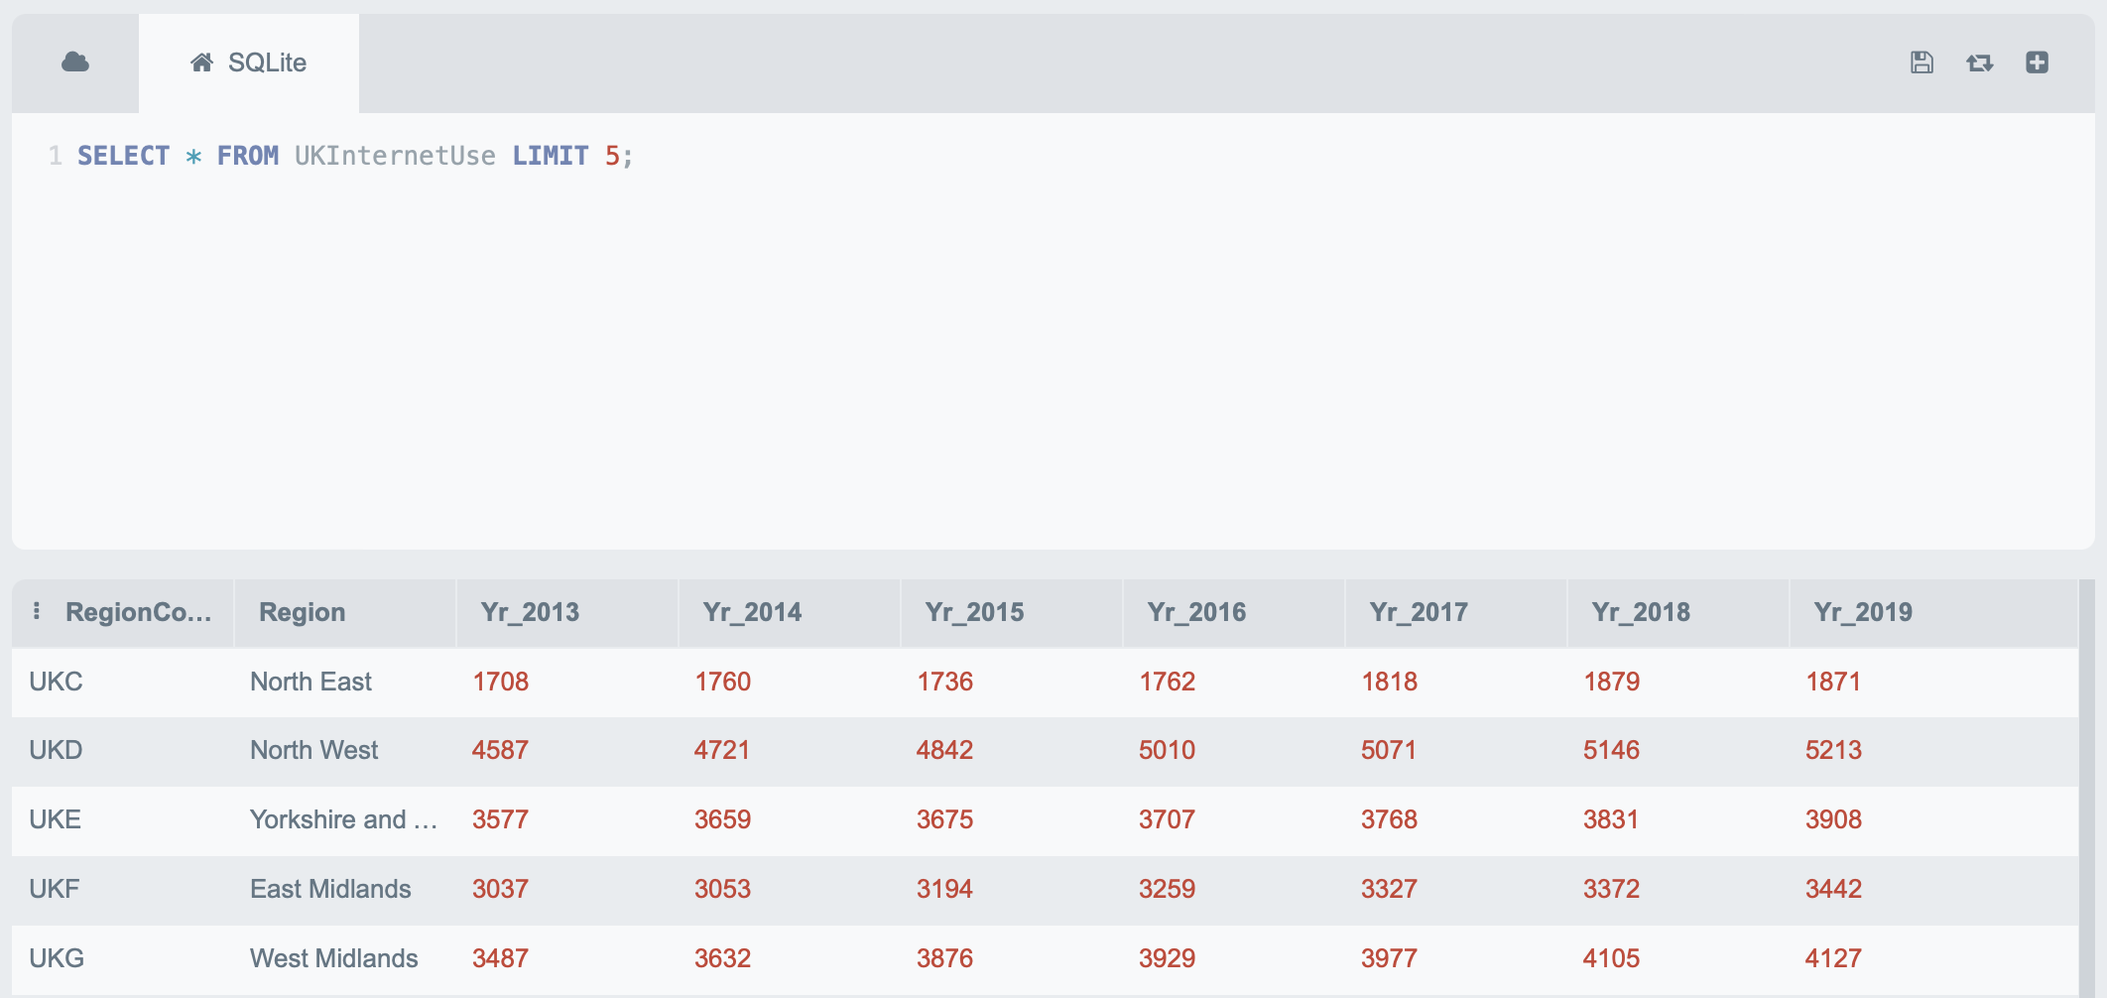
SELECT TOP

Slide 3
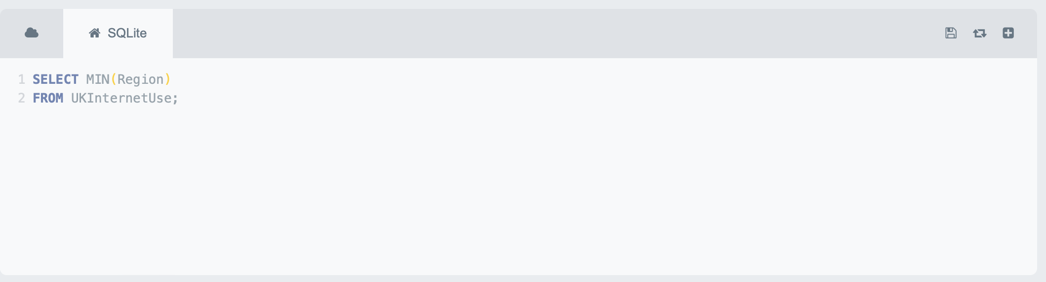
MIN

Slide 4
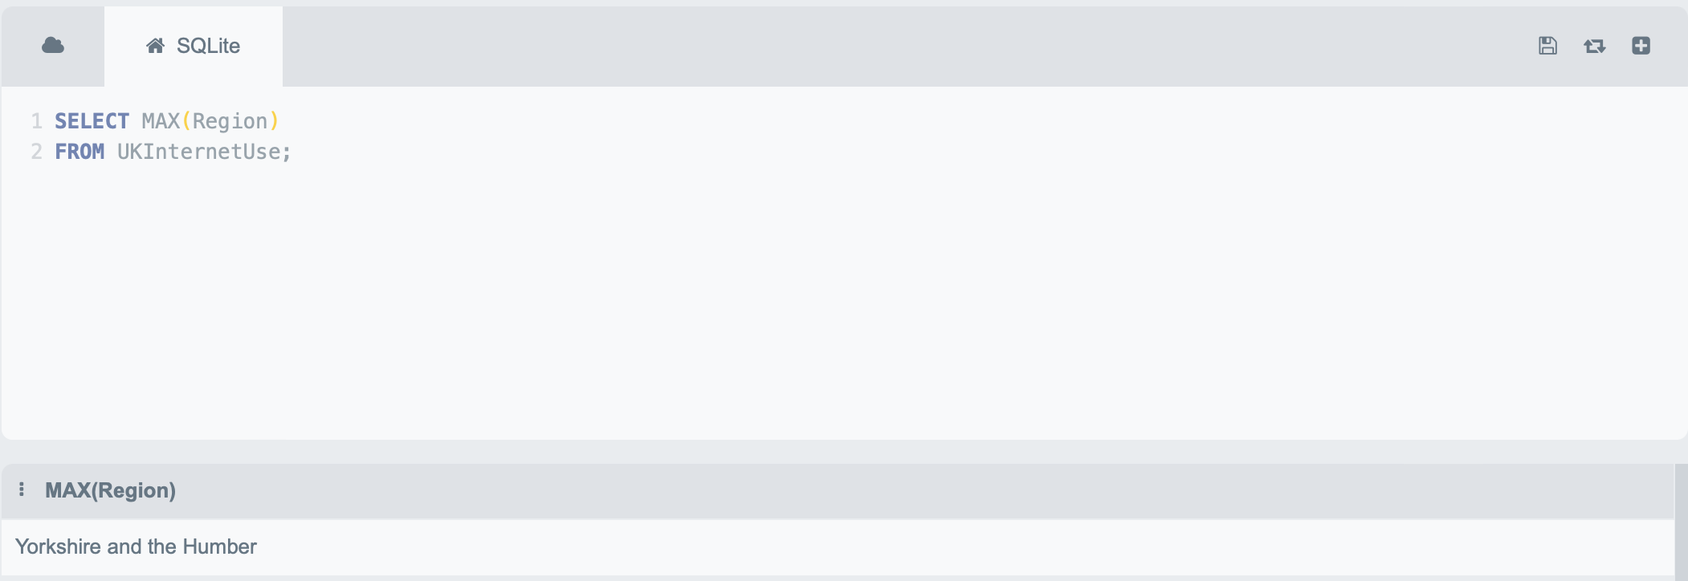
MAX

Slide 5
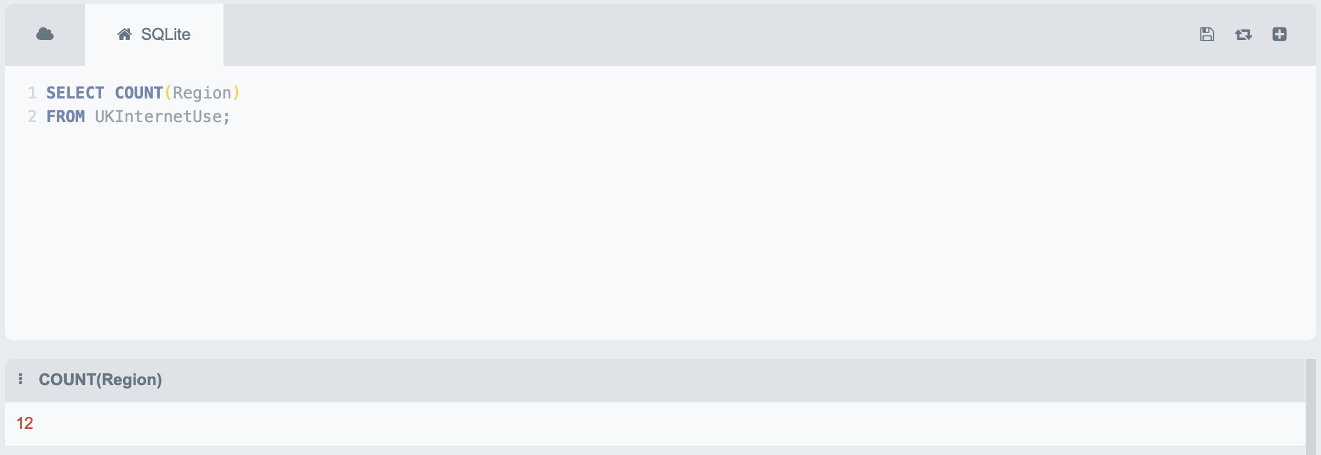
COUNT

Slide 6
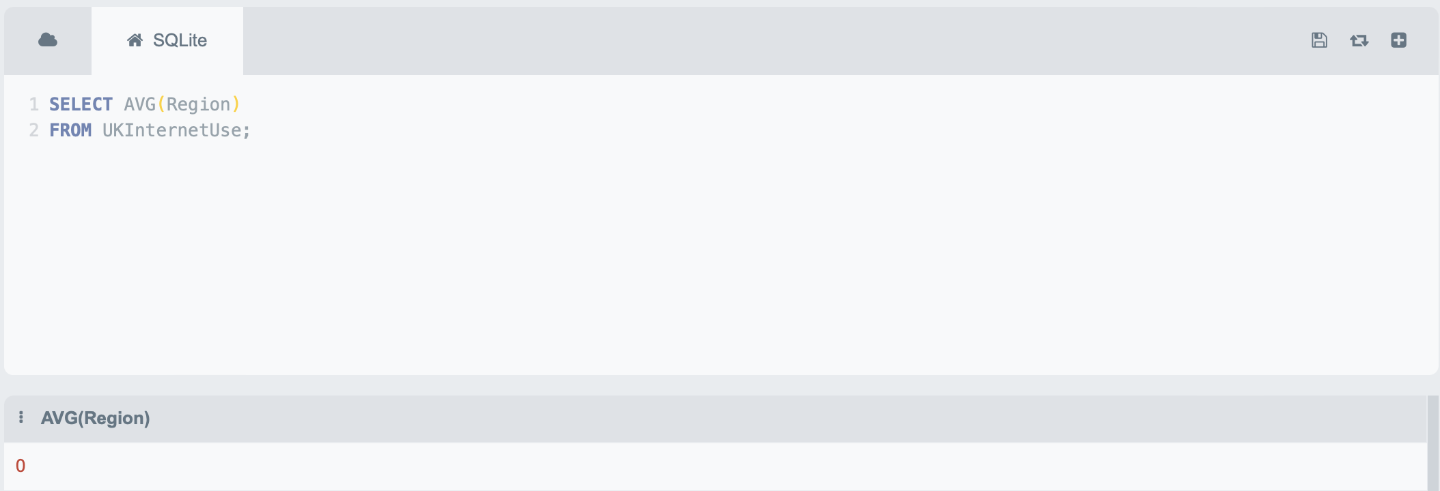
AVG

Slide 7

SUM

Slide 8
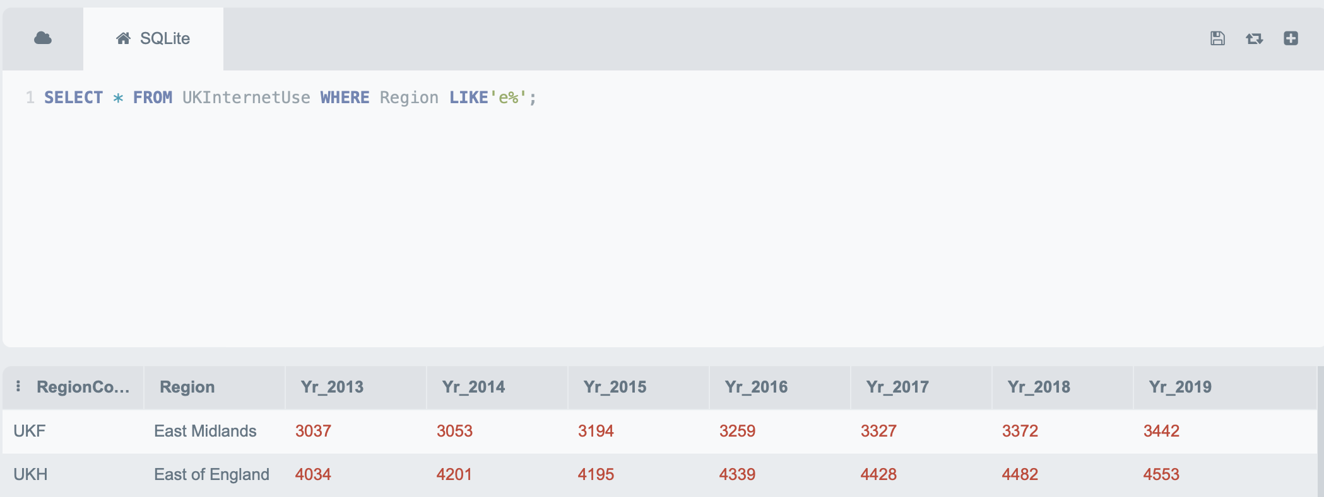
LIKE

Slide 9
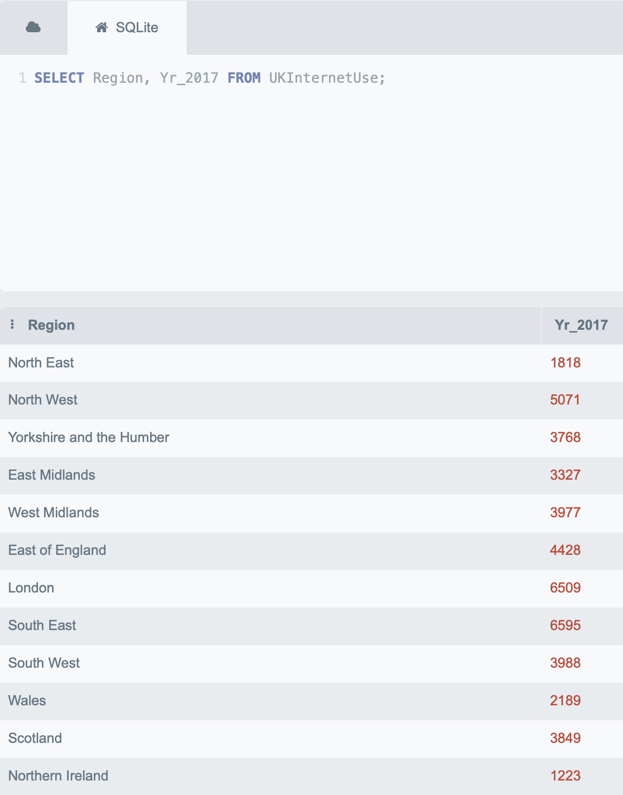
Write a query to get the region name and internet use for 2017

Slide 10
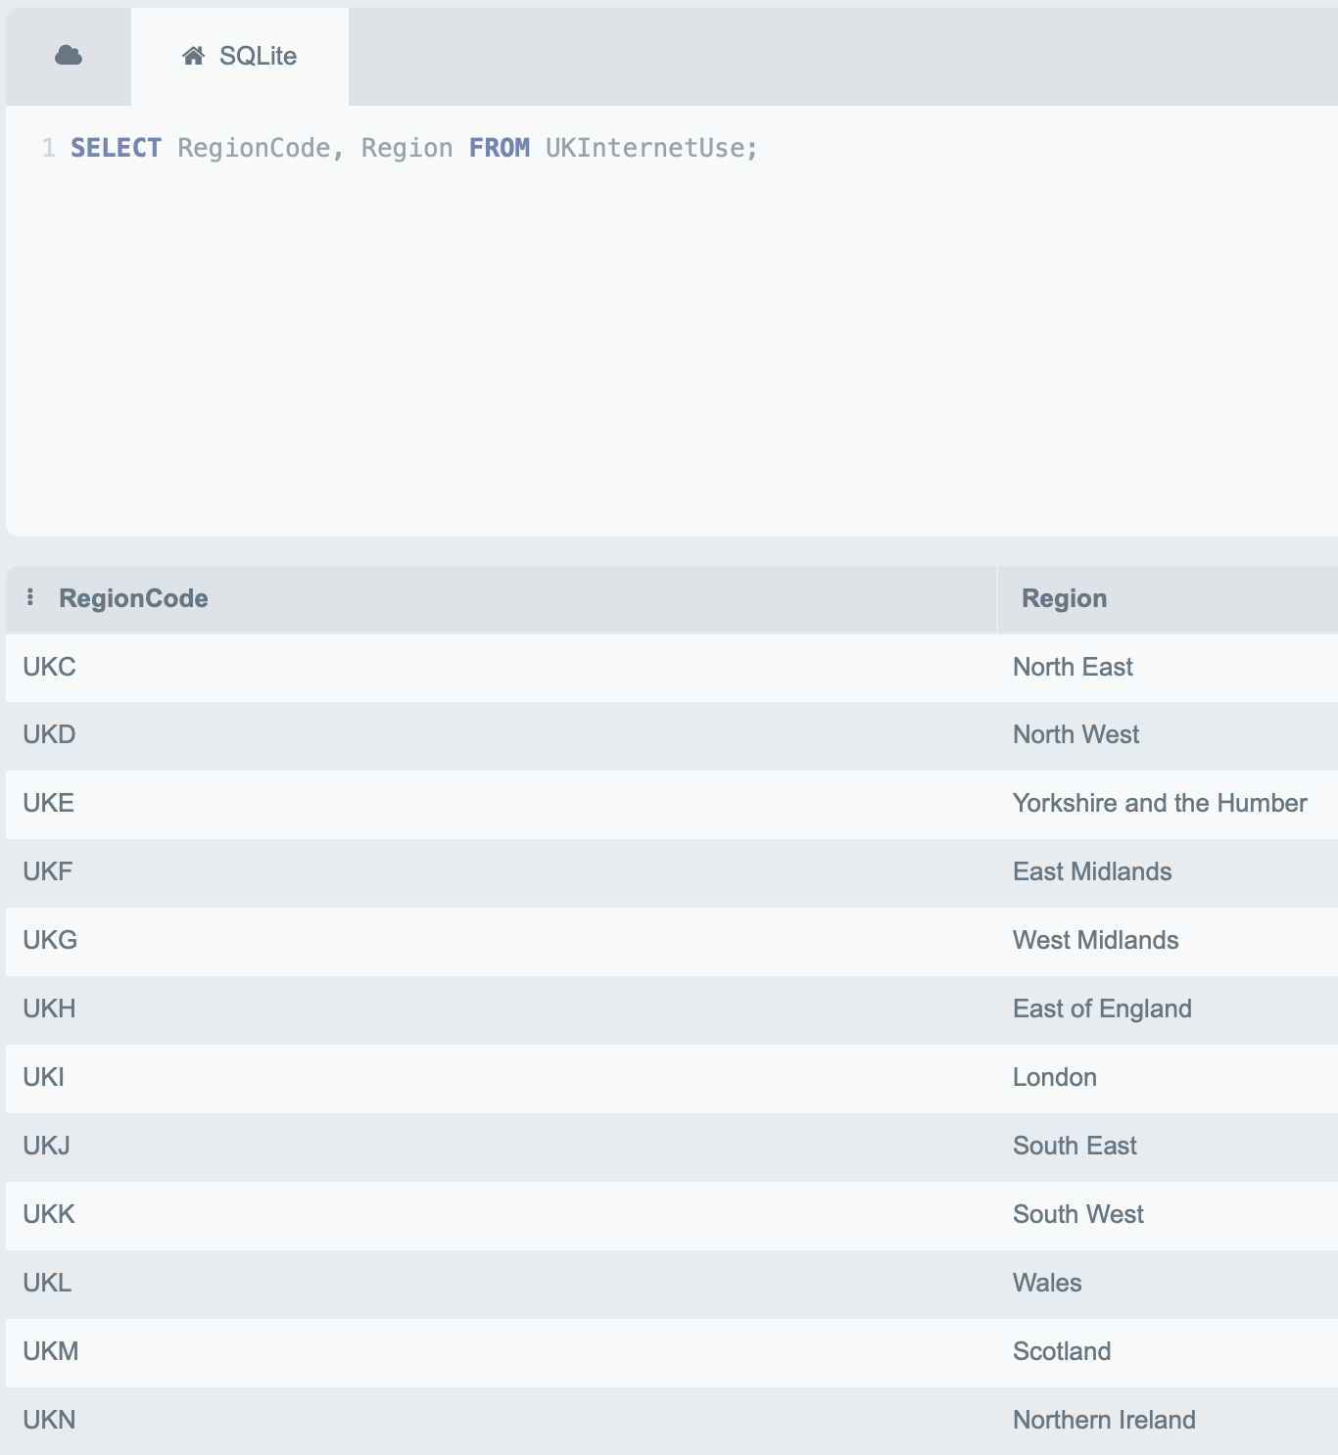
Write a query to get a region list (Region ID and Name)

Slide 11
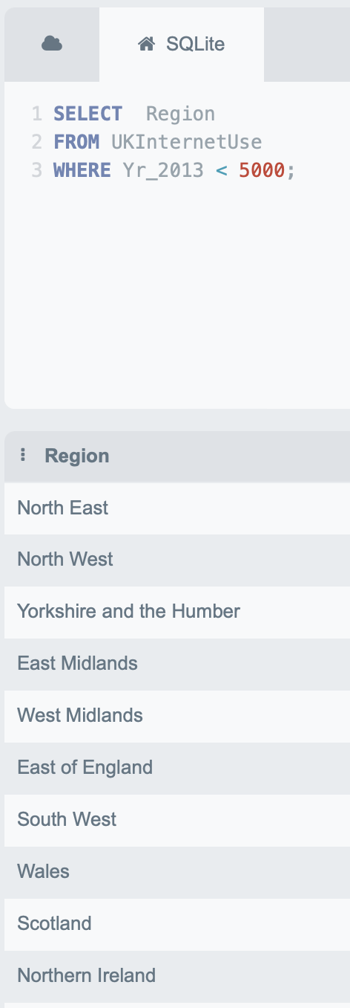
Write a query to get a list of regions with less than 5000 users in 2013 (region ID and Name)

Slide 12
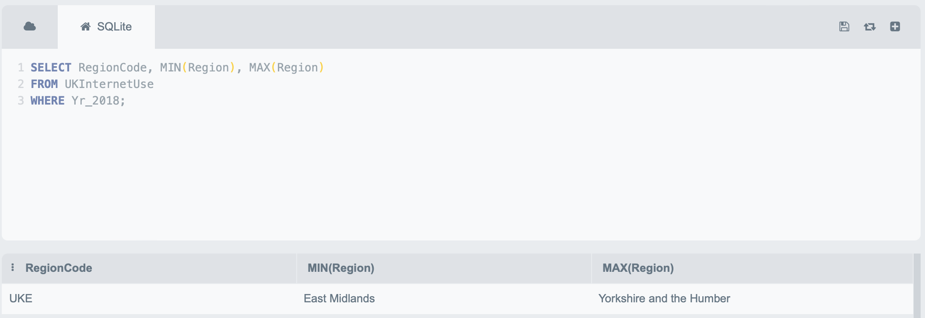
Write a query to get the highest and lowest region list in 2018 (ID and Name)

Slide 13
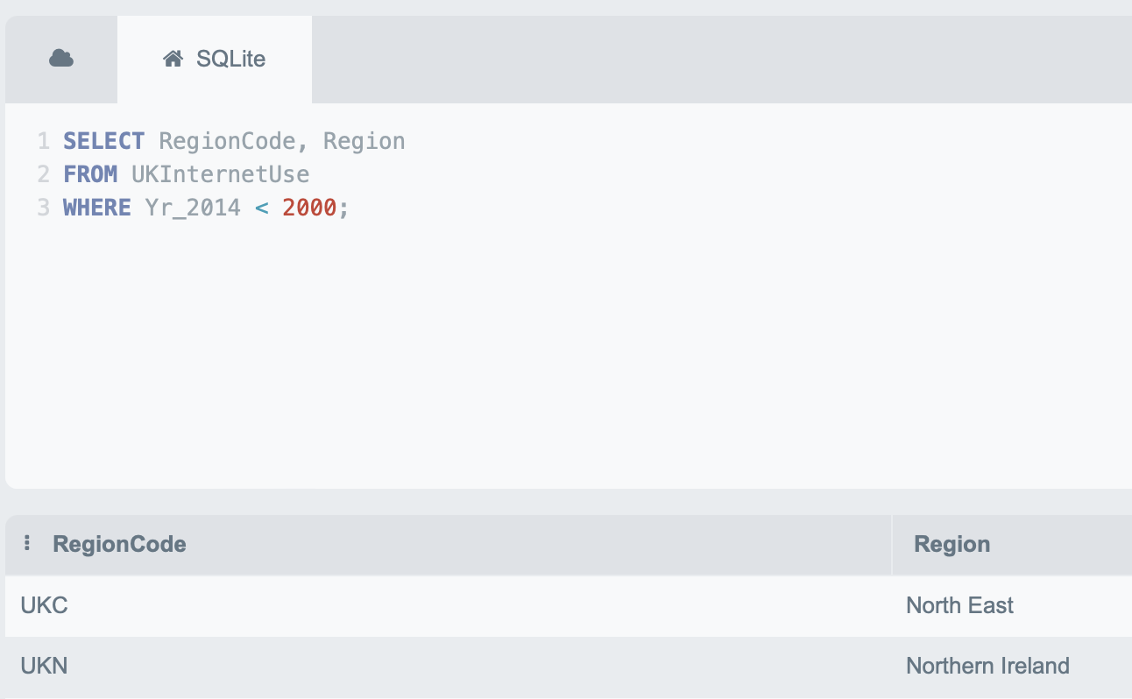
Write a query to get a region list (ID, Name) where the number of users is less than 2000 in 2014

Slide 14
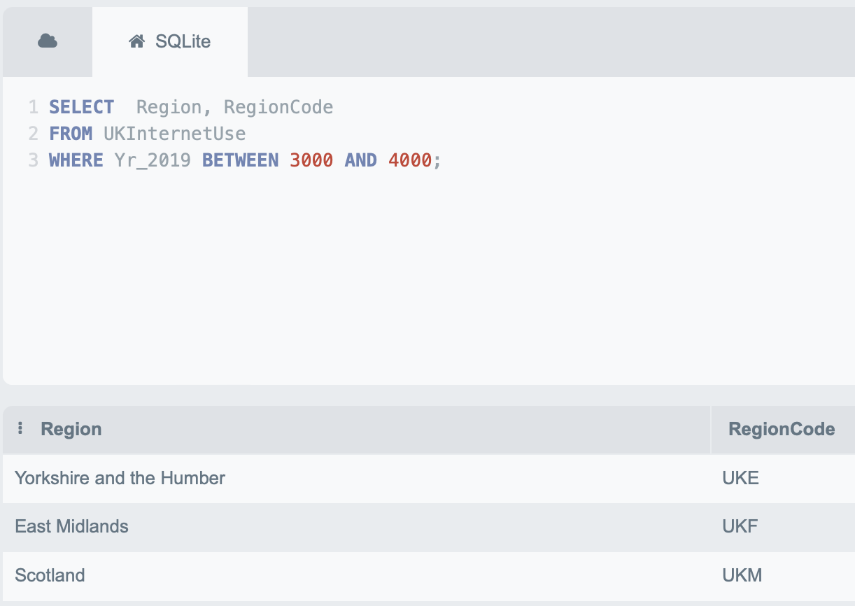
Write a query to get a region list (ID, Name) where the number of users is between 3000 and 4000 in 2019

Slide 15
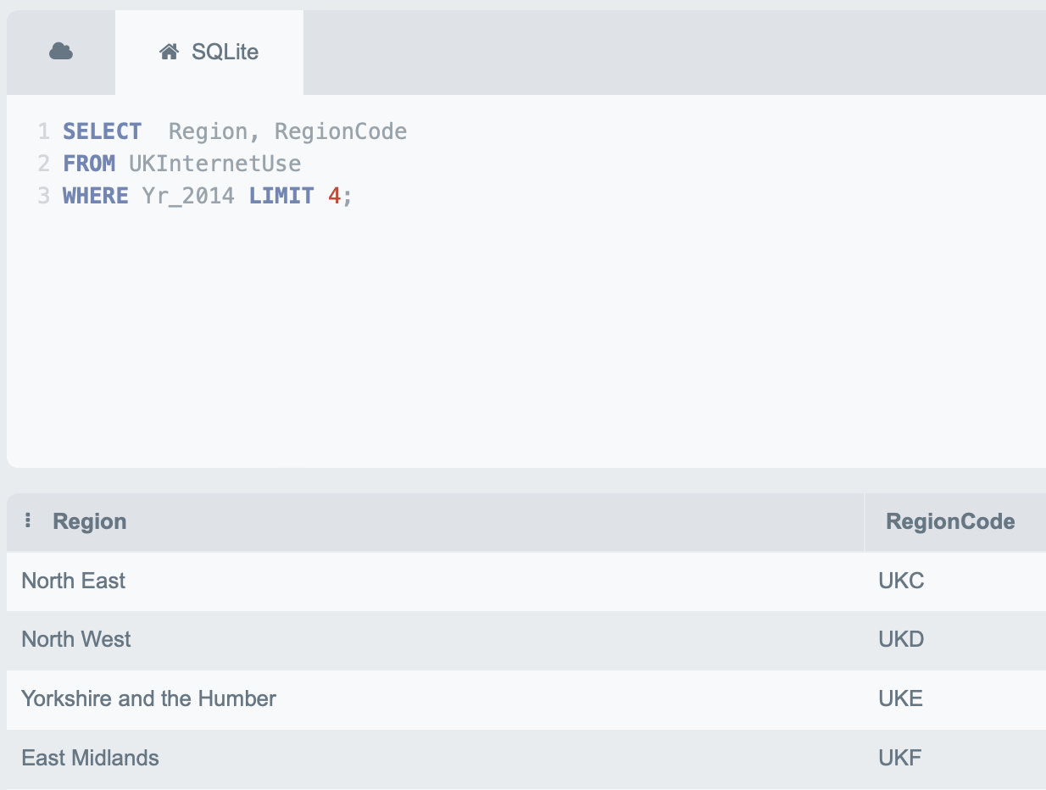
Write a query to get a region list (ID, Name) of the 4 regions with the highest number of users in 2014

